Slide 1
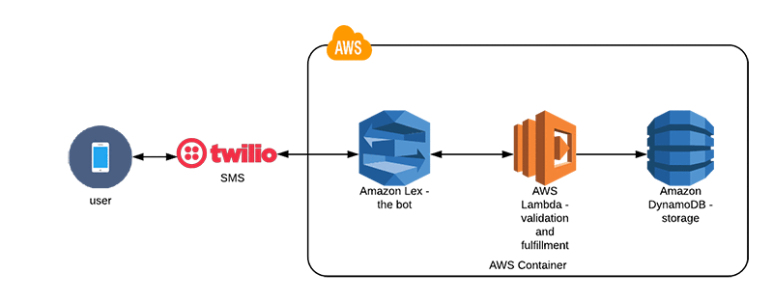
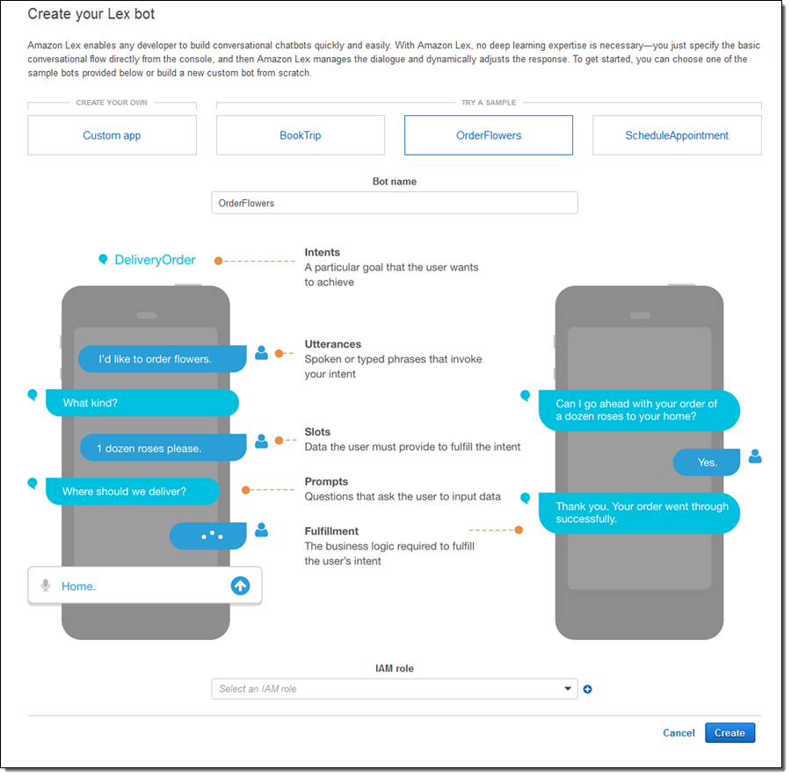
AWS Chat Bot with Twilio
Replacing GPRA Follow Up Survey with a chat bot
Plan to improve patient response rates by switching to a more interactive format

Slide 2






Format survey output and email to clinician
AWS Lambda Orchestration
AWS Lex
https://github.com/canallc/aws-lex-healthcare-chat-bot/tree/master

Slide 3
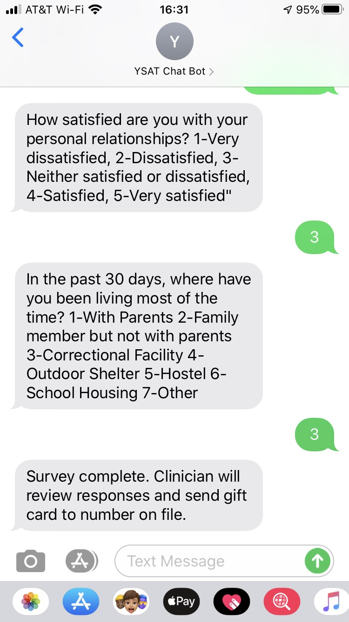
Mobile Phone

Slide 4
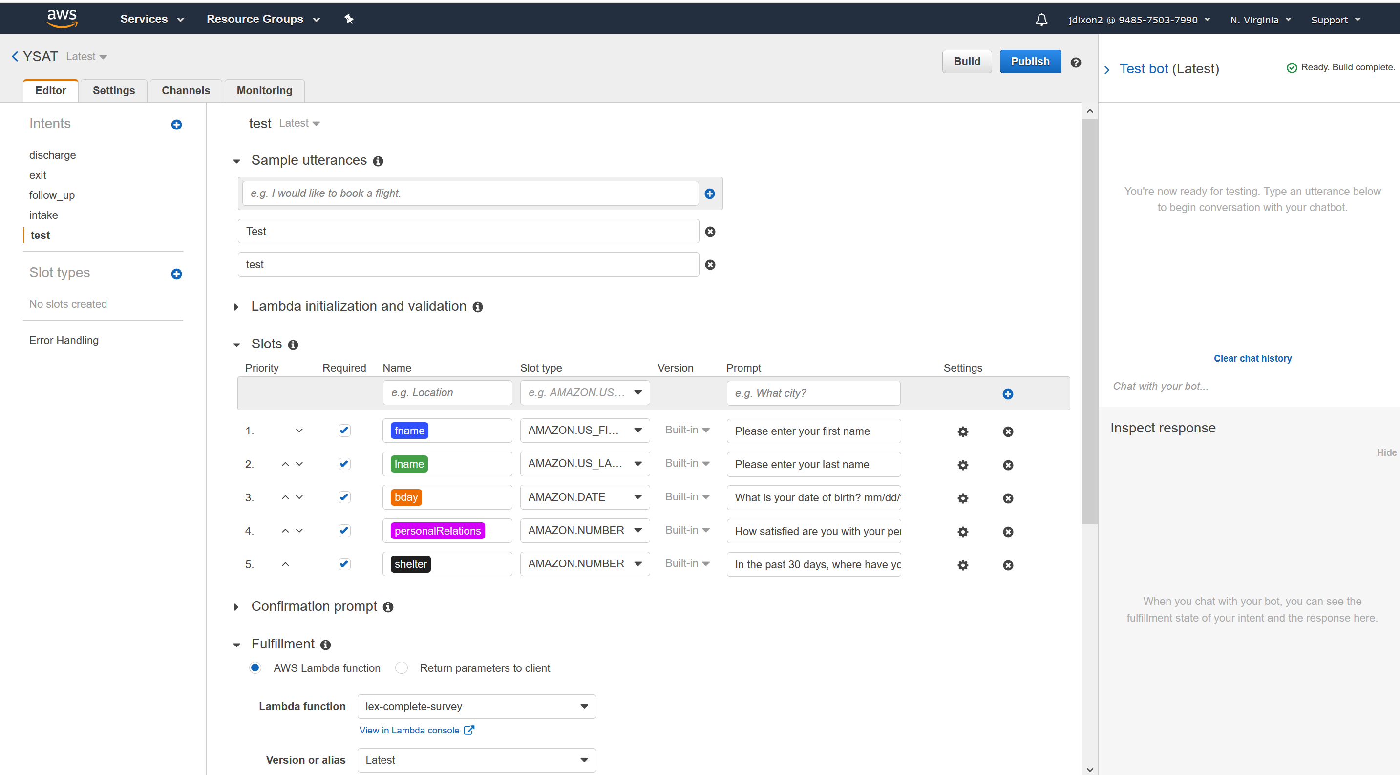
AWS Lex

Slide 5
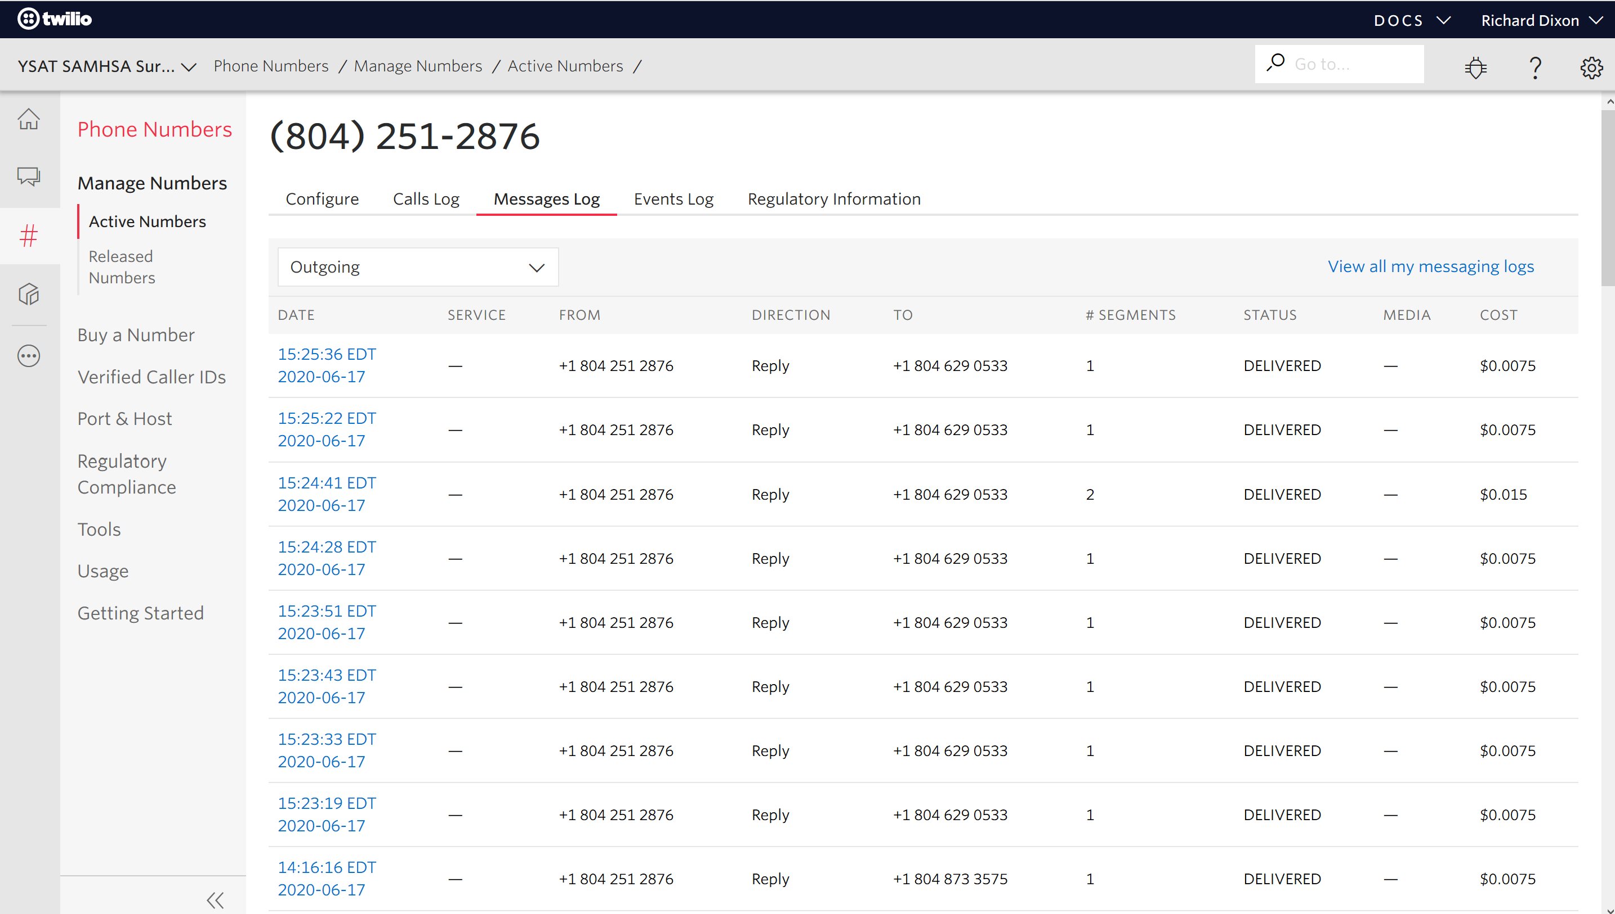
Twilio

Slide 6
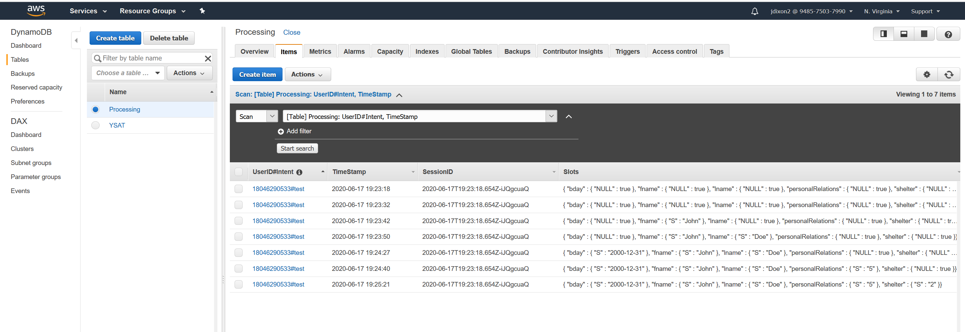
DynamoDB – NoSQL Table 1 for Transaction Processing

Slide 7
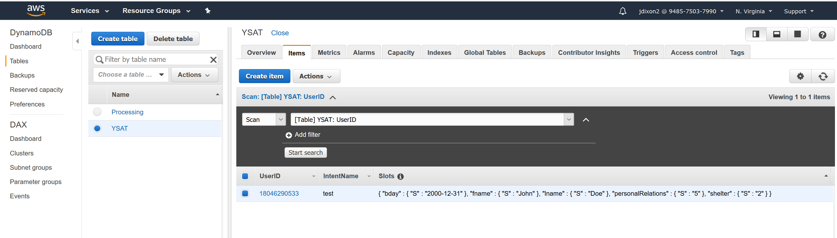
DynamoDB – NoSQL Table 2 for Email Processing

Slide 8
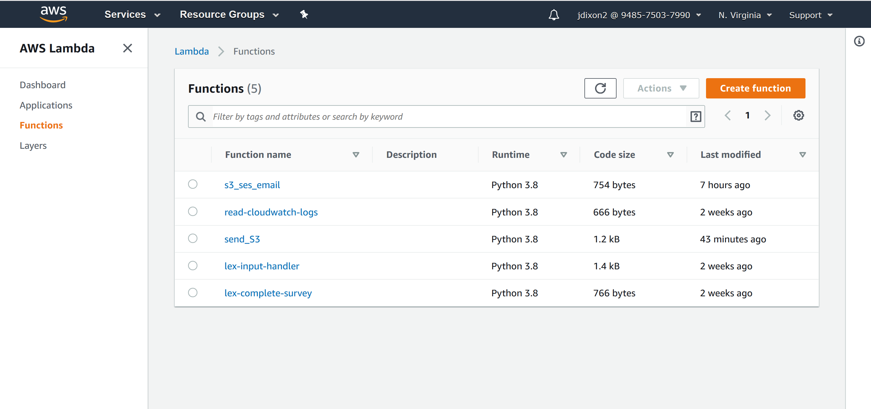
AWS Lambda – Workflow Orchestration and Data Wrangling
https://github.com/canallc/aws-lex-healthcare-chat-bot/tree/master

Slide 9
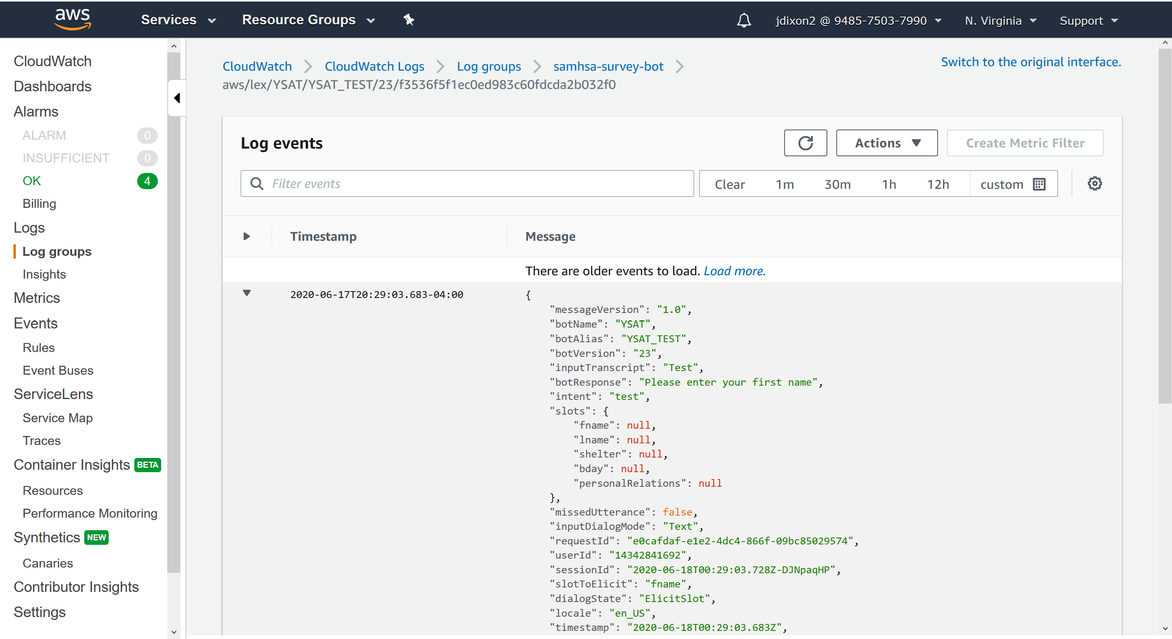
AWS CloudWatch
(Used to get sessionIDs for final DynamoDB table)

Slide 10
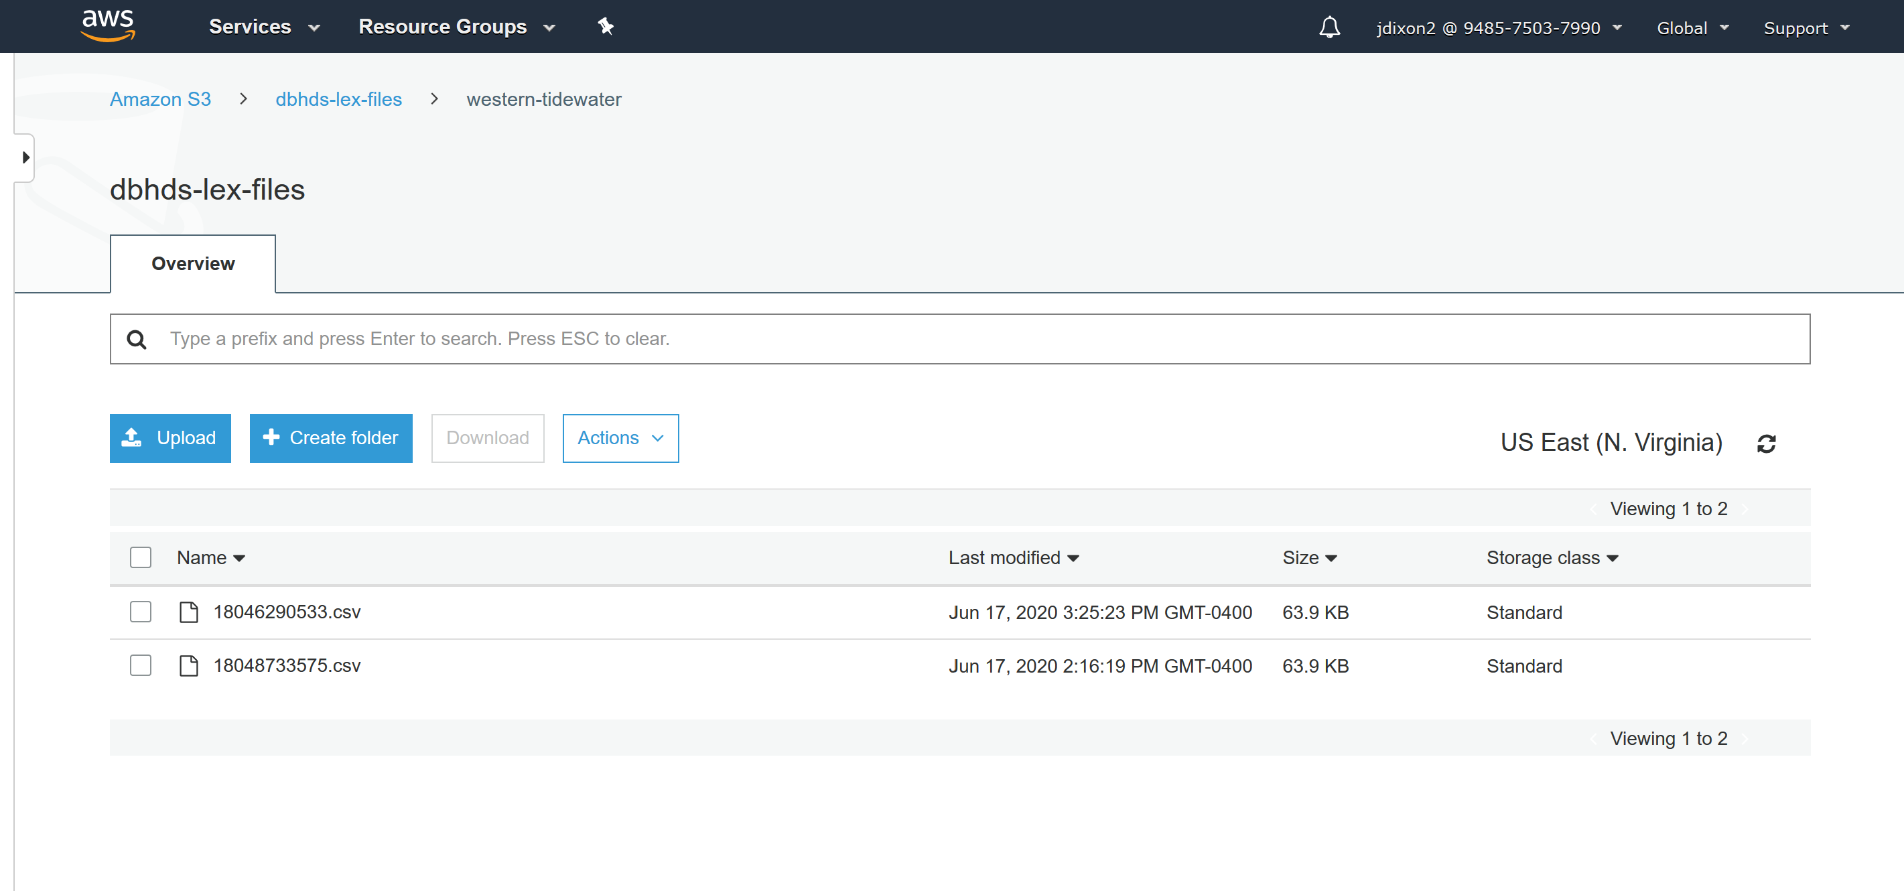
AWS Simple Storage Service (S3) – Trigger for SES Email

Slide 11
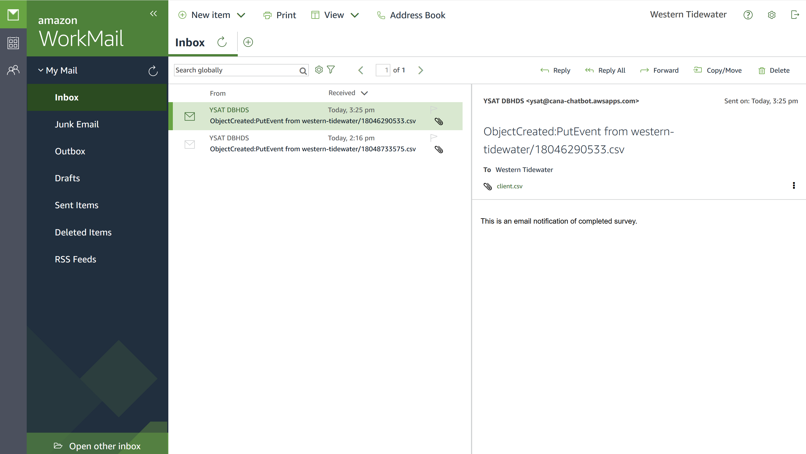
AWS Simple Email Service (SES) / AWS WorkMail

Slide 12
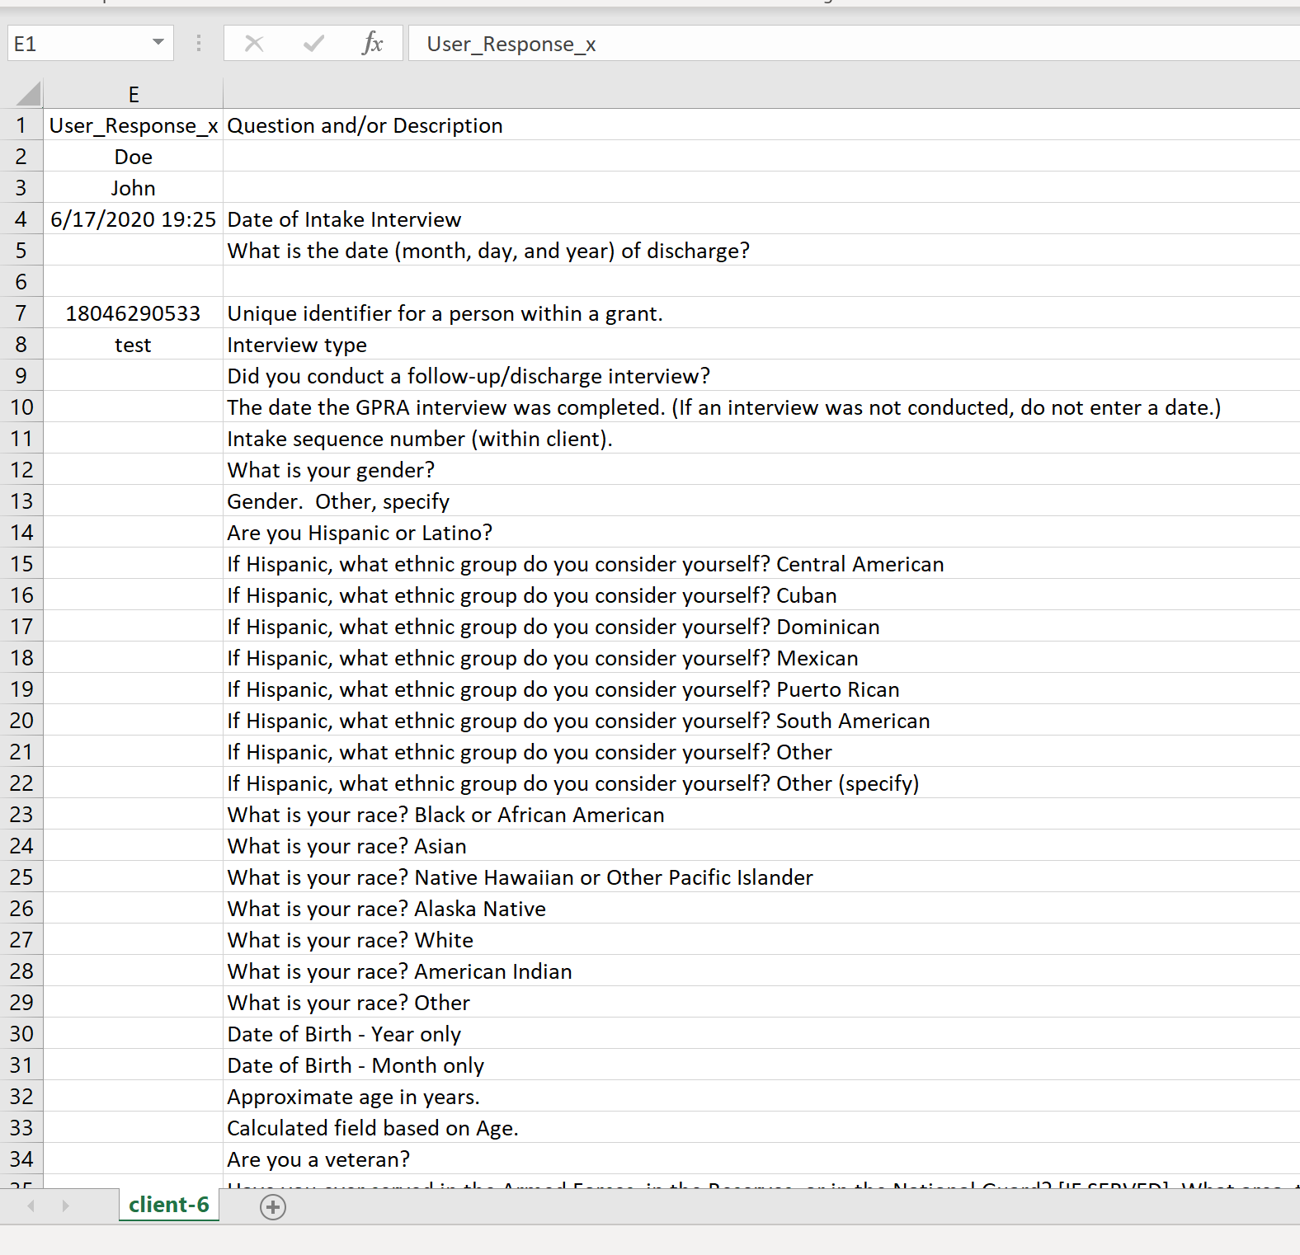
CSV file

